Slide 1

Registration plate / license plate Detection System using Machine learning and image processing

Slide 2
Registration plate / license plate Detection System using Machine learning and Image processing
about project.
Types of vehicles And their registration plates.
Rate of accidents in India (state wise analysis) .

Slide 3
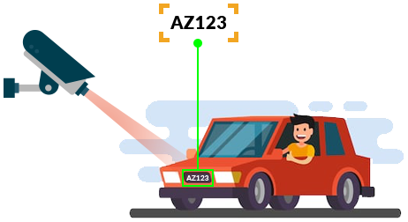
About the project
As we all know that these days E-challan is very common. But, do you know you can skip or trick the cameras used by just using fancy/normal number plates instead of using the High-Security Registration Plates (HSRP). But we don’t know totally about it! in reality, it is not fully automated it is semi-automated as one of the traffic officers issues the challan from a traffic control room. The cameras just only capture the picture of the vehicle.

Slide 4
About the project
This project will fully automate the procedure of E-challan and even this system will detect both the number plates which are fancy/normal as well as HSRP.

Slide 5
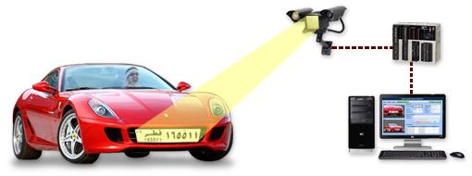
Problem If the System is not automated
As we all are human and we humans do a lot of mistakes, so in some way traffic officers may also get mistaken or sometime may skip some of the vehicles or may not respond on time.In many cases system is unable to determine the registration plates as well because those registration plates are either fancy ones or normal pained one which is undetectable by cameras. So, the solution to the above problem is to fully automate the system of E-challan instead of being a semi-automated system that can identify any type of registration plate and this will also benefit the Government of INDIA.
Sorry!
Registration plate cannot be identified.
!

Slide 6
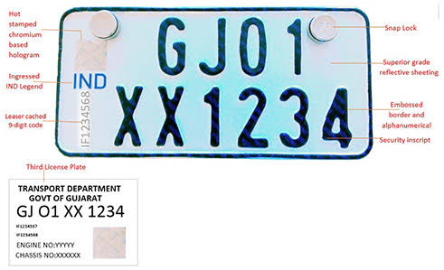
How HSRP works?
These are Special type of clamps that can be used only once and that too very tough to remove

Slide 7
Types of vehicles
(used now a days)
Types of vehicles
E-vehicles
Petrol/CNG vehicles
Diesel Vehicles

Slide 8



Types of vehicles
E-vehicle :-
These are the vehicles that are said to have 0% carbon emission which means these vehicles do not require any fuel to burn instead these run on rechargeable batteries.
Petrol / CNG vehicle :-
These vehicle uses fossil fuel to run the vehicle these vehicles have piston and cylinder arrangement where the combustion(fuel is burned) takes place and the fuel is either petrol or CNG(compressed natural gas) and produces carbon-di-oxide, carbon mono-oxide, sulphur dioxide, etc gases. It is used in Light vehicles.
Diesel vehicle :-
These vehicle uses fossil fuel to run the vehicle these vehicles have piston and cylinder arrangement where the combustion(fuel is burned) takes place and the fuel is Diesel and which produces carbon-di-oxide, carbon monoxide, sulphur dioxide, etc gases. It is used in Heavy vehicles.

Slide 9
Types of Registration plates
(used now a days)
Normal/fancy
Registration plate
HSRP
(High Security Registration Plate )

Slide 10
Types of HSRP ( in vehicles )
Types of HSRP
Electric
( Green )
Private
( White / Gray )
Commercial
/ Public
( Yellow)
Rental / Self-Driven
( Black )
Embassy or Consulate
( Sky blue )
Military
( Mud Brown )
President / Governor of state
( Red )

Slide 11
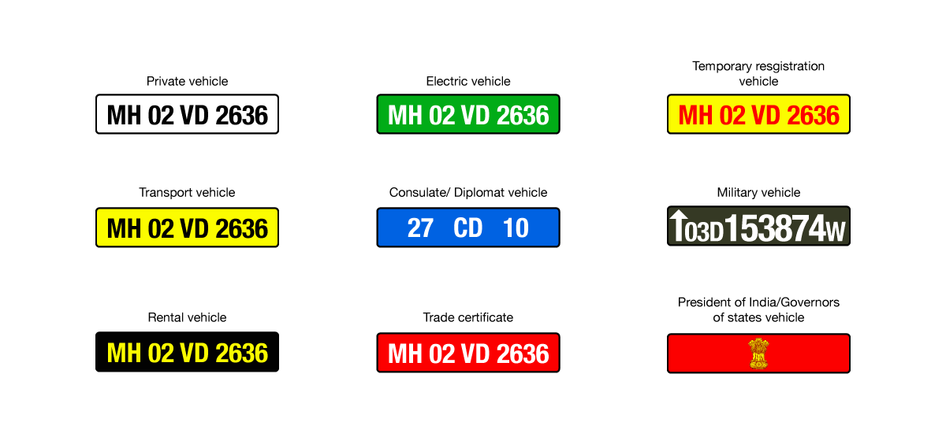
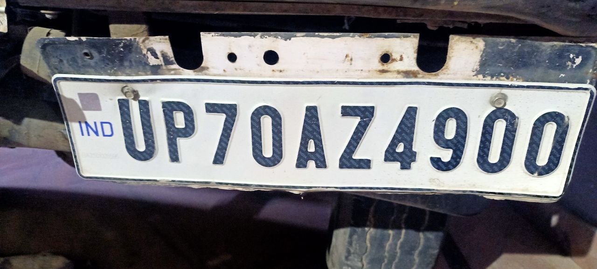
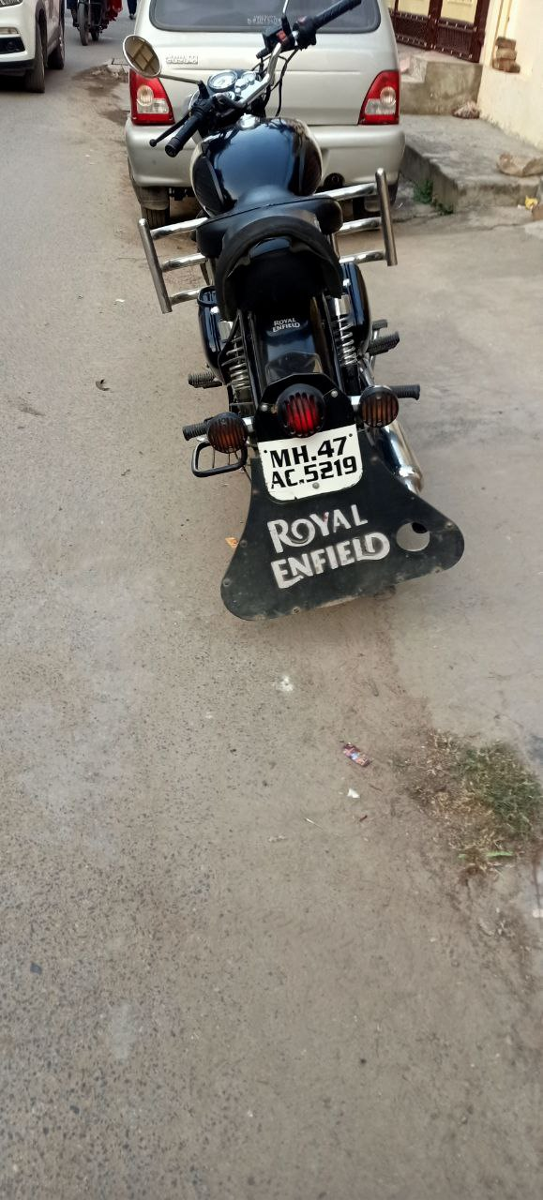
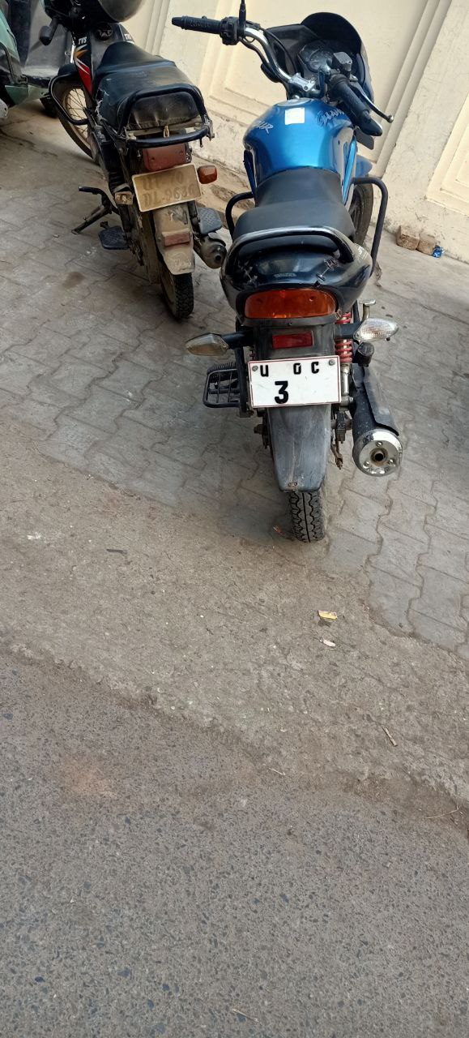
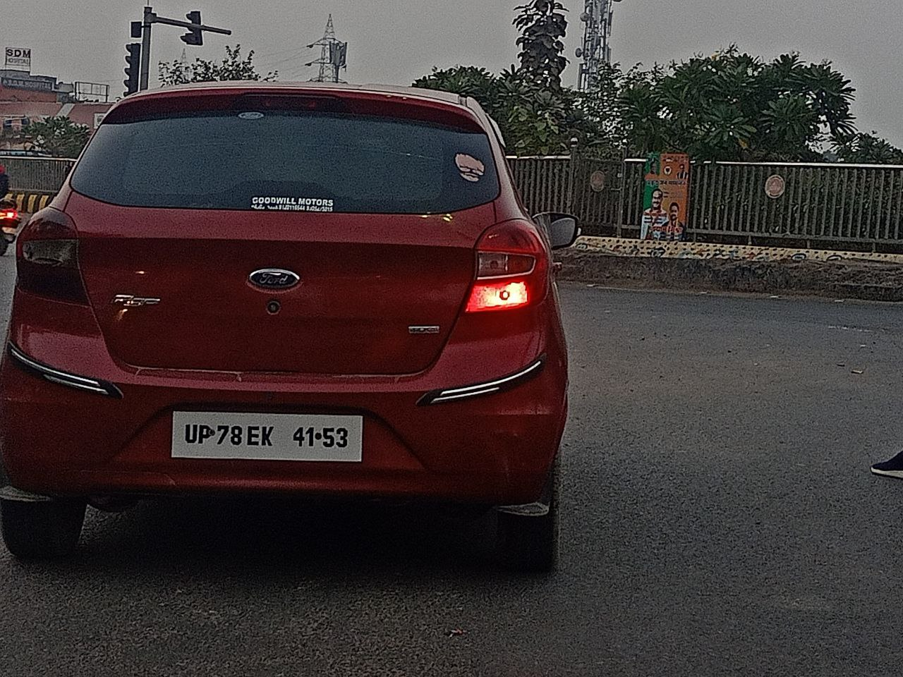
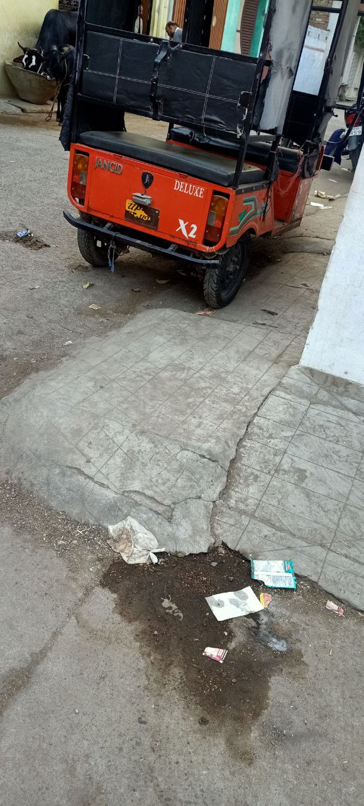
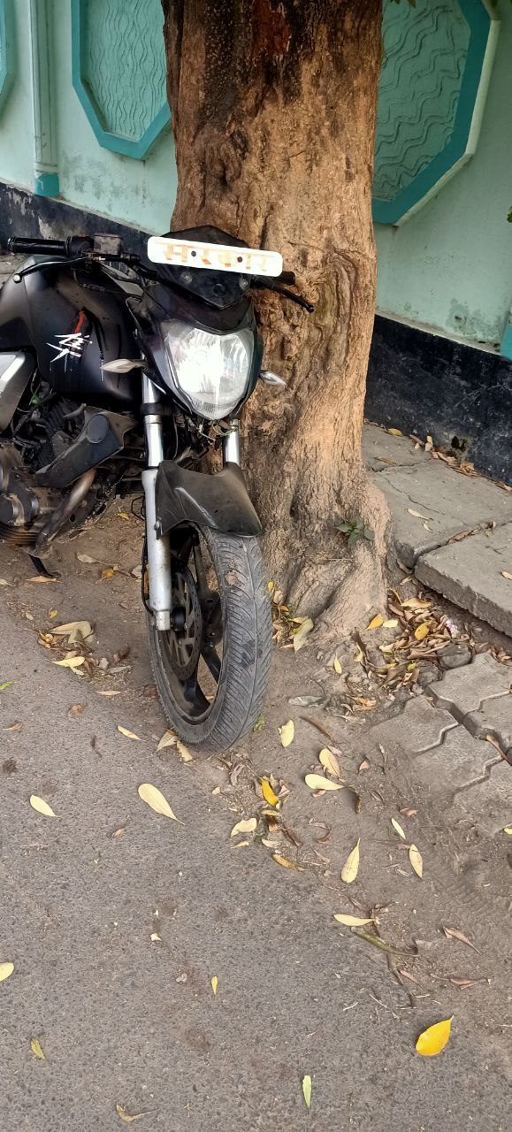
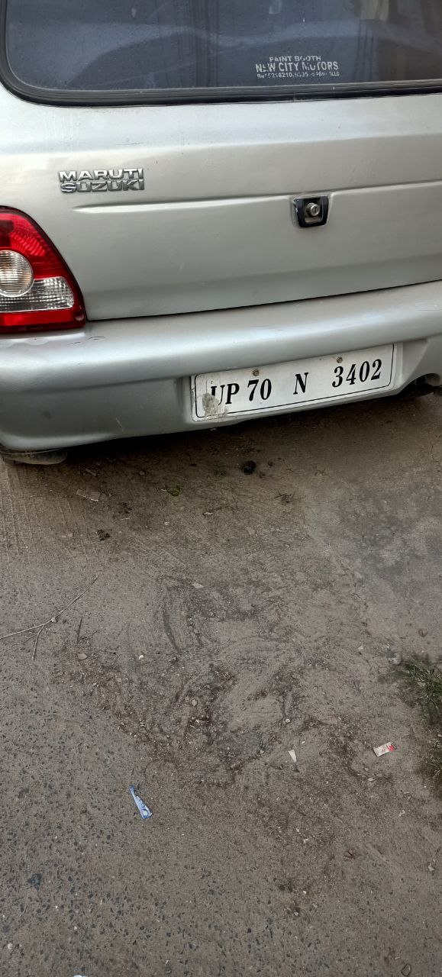
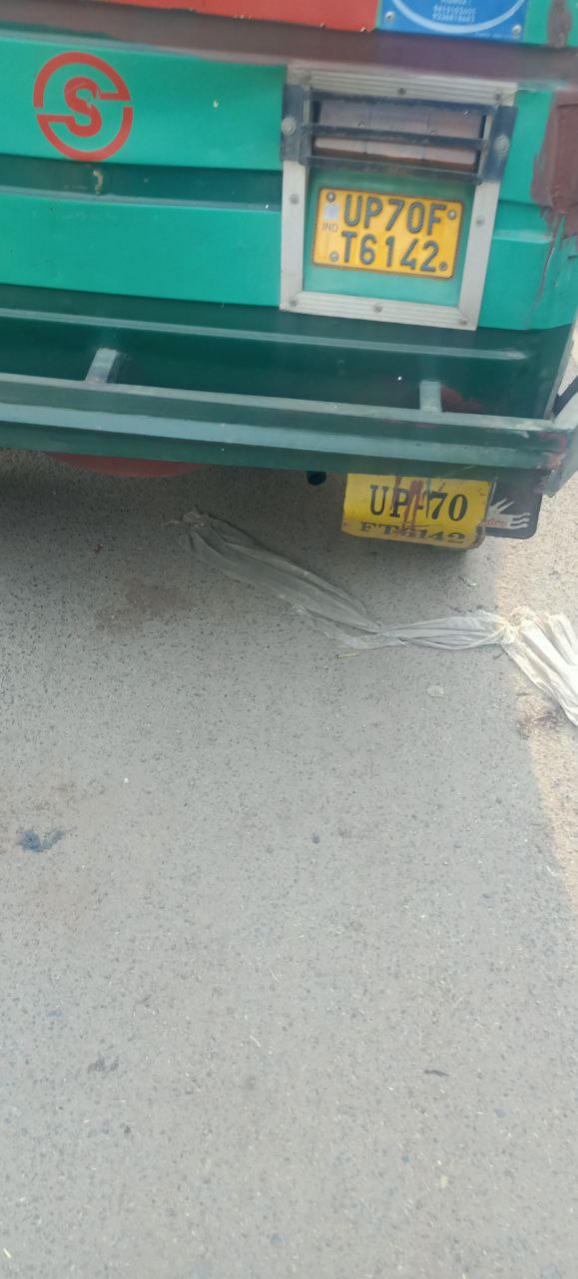
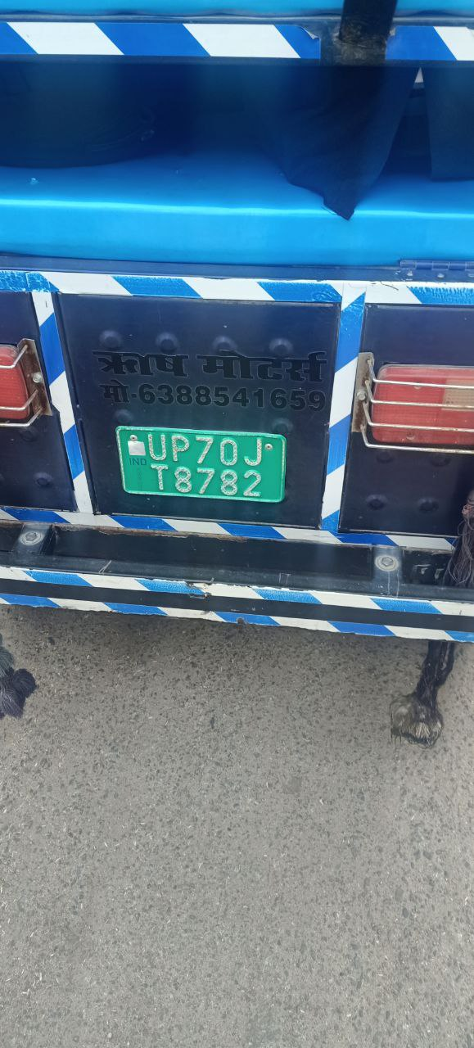
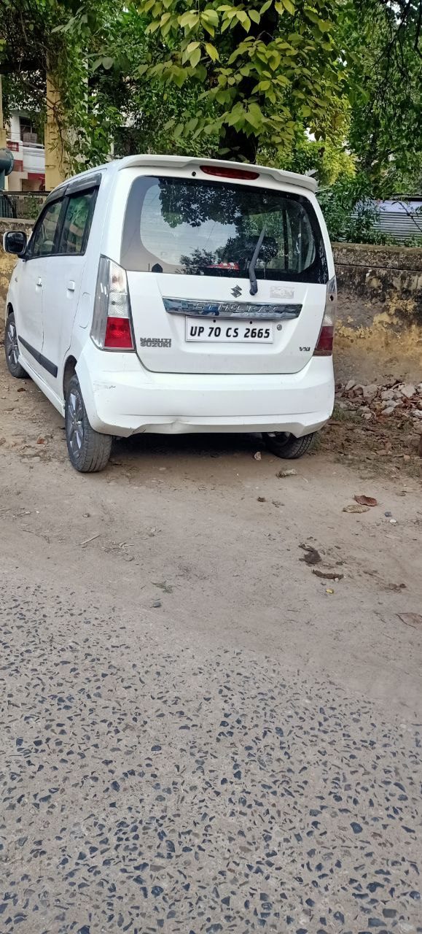
















Some examples of HSRP and Normal/Fancy number plates
HSRP
Normal / fancy

Slide 12
Types of HSRP
There are different types of HSRPs used by the GOVERNMENT OF INDIA that helps the camera to identify which type of vehicle category that vehicle belongs to.
For eg
Sky blue color denotes that the vehicle is embassy vehicle i.e. that is internationally registered, in the same way, the red color denotes the vehicle of the President of INDIA & state governors. So, different colors denoted different meanings and that tells the traffic authorities that the challan will be made or not, etc.
This is not only good for traffic officers but also it is helpful for us as well if we know deeply about these things then we can directly tell which type of registration is done for that particular vehicle and makes us more aware if we are travelling for long distances.

Slide 13
Graph depicting the number of road accidents reported in the year 2020 (state wise)

Slide 14
Briefing of graph & why accidents occur?
The above graph shows that according to the analysis done in 2020 the most accidents occurred in Tamil Nadu approximately 45000 and the least accident occurred in Lakshadweep approximately none.
* But do you know why these accidents occur?
These accidents were due to the following reasons:-
1)Due to over-speeding.
2)Due to a Lack of safety measures.
3)Poor visibility.
4)Underage driving.
5)Red light violations.
6)And many more things that one does not follow while driving/riding.

Slide 15
Conclusion
After finding all these problems to resolve these problems we are designing an advanced system that automatically detects the speed of a vehicle and makes a fine if any problem is found as mentioned above, any violation, any type of in obedience which not permittable this system will automatically identify that and will do the best of it.
In some cases, we know that this is not the solution to the problem but after a detailed analysis, it is found that no one wants to pay challan or they get surprised when they come to know about the challan.
This is because challan plays a crucial role when one wants to sell or buy any vehicle. That is why no one wants that their vehicle has a challan.
So after the implementation of this system the rate of accidents will drop as everyone will become aware that the challan will be made on their smallest mistake.

Slide 16
Thankyou

